Slide 1
Newchurch Village Community Association

Slide 2
There are four areas we wish to register in Newchurch:-
1).The Bowling Green at The Boars Head
2). The Car Park at the Boars Head
3). The Little Park
4). The Car Park adjacent to the North side of St. Nicholas' Church.

Slide 3
1). The Bowling Green at The Boars Head, Newchurch.

Slide 4
LCC Map of Site

Slide 5
Aerial View of Site

Slide 6
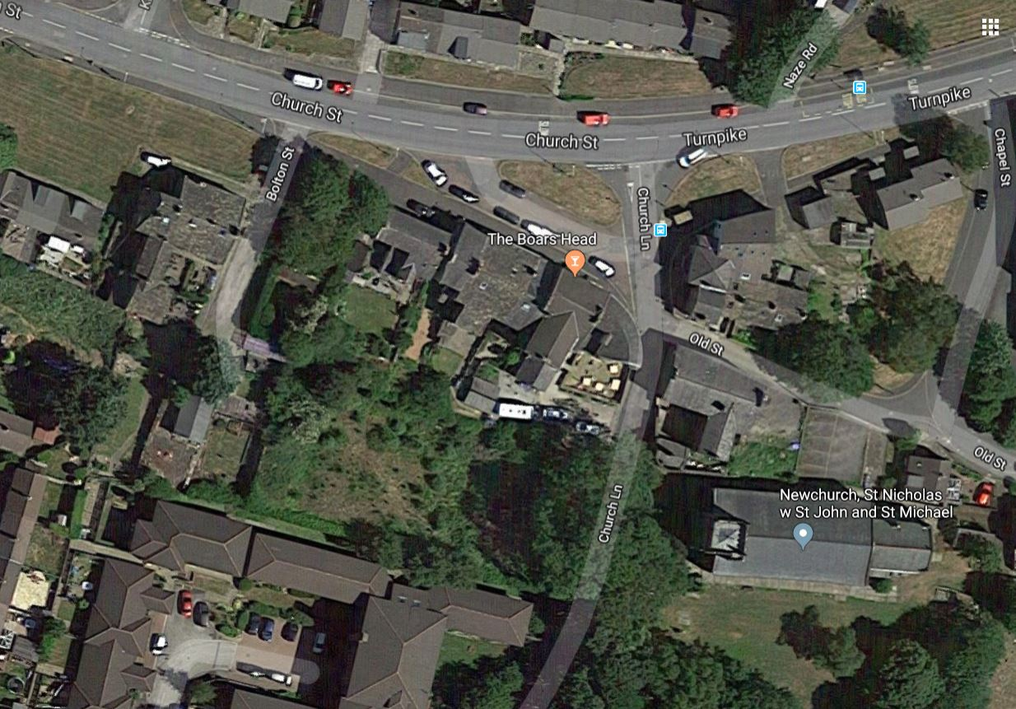
Aerial View of Site – 2

Slide 7
The Bowling Green at The Boars Head, Newchurch
There has been a Bowling Green behind the Boars Head going back beyond living memory. In the late 1970’s it had been turned into a couple of allotments, and there was a pigeon loft on the site. In 1982, Brian Melileu took over the lease at the Boars Head, and under his tenure, the bowling green was restored.

Slide 8
The Relaying of the Bowling Green c.1983

Slide 9
The Relaying of the Bowling Green c.1983

Slide 10
The Relaying of the Bowling Green c.1983

Slide 11
The Relaying of the Bowling Green c.1983

Slide 12
The Bowling Green 1980’s

Slide 13
The Bowling Green 1980’s

Slide 14
The Bowling Green March 2011

Slide 15
The Bowling Green March 2011

Slide 16
The Bowling Green March 2011

Slide 17
The Bowling Green March 2011

Slide 18
The Bowling Green March 2011 -Looking towards Bolton Street

Slide 19
The Bowling Green March 2011

Slide 20
The Bowling Green March 2011

Slide 21
May 2011

Slide 22
May 2011

Slide 23
May 2011

Slide 24
May 2011

Slide 25
October 2011

Slide 26
October 2011

Slide 27
October 2011

Slide 28
October 2011

Slide 29
August 2012

Slide 30
August 2012

Slide 31
August 2012

Slide 32
August 2012

Slide 33
October 2012

Slide 34
October 2012

Slide 35
October 2012

Slide 36
October 2012

Slide 37
Jake Berry MP inspected the site with members of the NVCA – August 2014

Slide 38
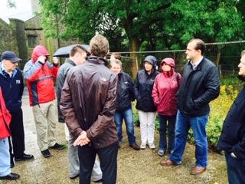
Jake Berry MP inspected the site with members of the NVCA – August 2014

Slide 39
Newchurch Village Community Association

